Slide 1
Debuging WORKSHOP
GCC 4.1.2 STL Implementation

Slide 2
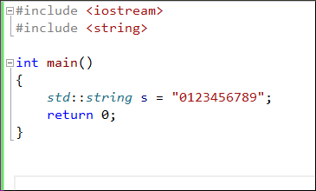
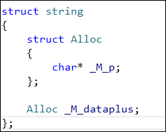
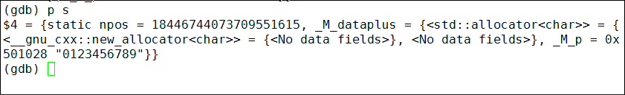

gcc4.1.2 STL Inside——STRING

Slide 3
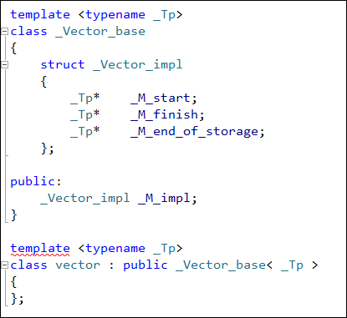
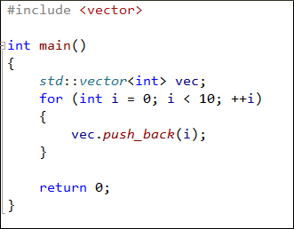
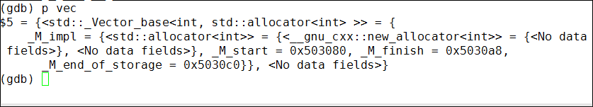
gcc4.1.2 STL Inside——vector
_M_end_of_stroage
0
1
2
^
_M_start
_M_finish

Slide 4
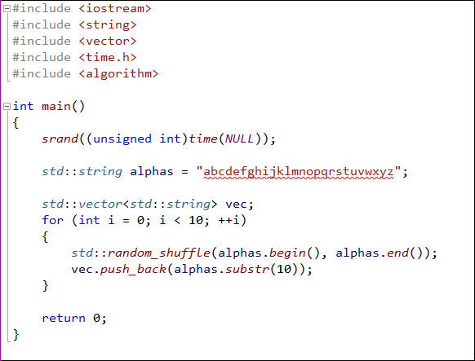
练习一
用x命令观察随机生成的字符串

Slide 5
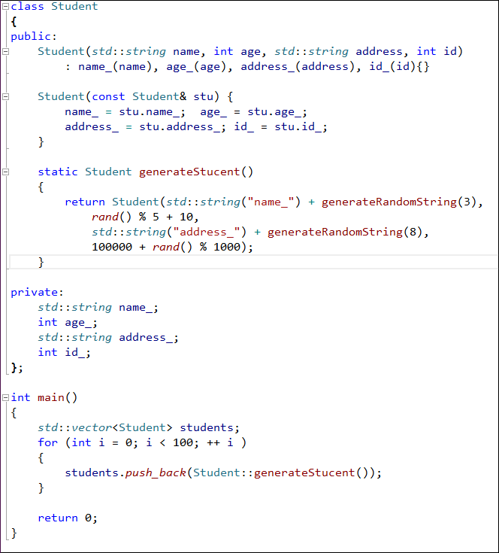
练习二
找出第99个学生的信息

Slide 6
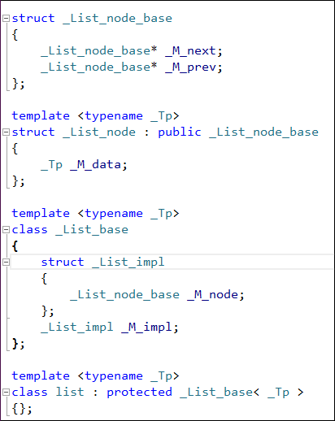
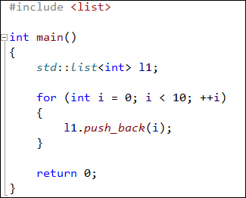
gcc4.1.2 STL Inside——LIST
_M_impl
_M_next
_M_prev
_M_next
_M_next
_M_next
_M_prev
_M_prev
_M_prev
_M_data
_M_data
_M_data

Slide 7
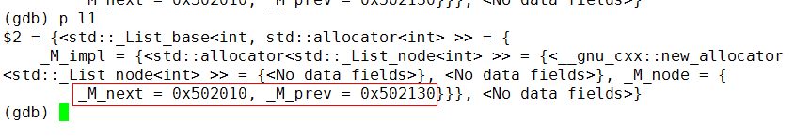
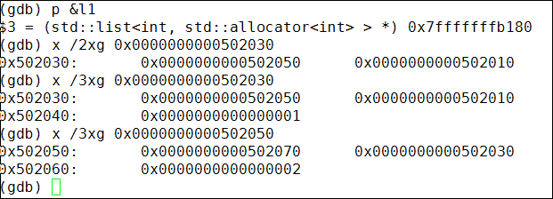
gcc4.1.2 STL Inside——LIST
_M_impl
_M_next
_M_prev
_M_next
_M_next
_M_next
_M_prev
_M_prev
_M_prev
_M_data
_M_data
_M_data

Slide 8
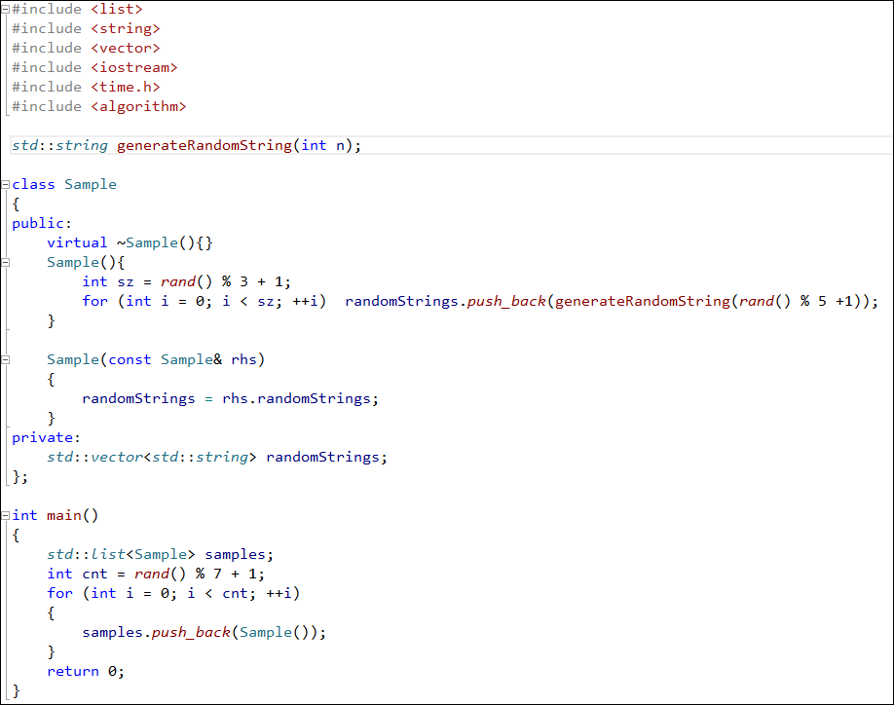
练习三
给出samples中的全部信息

Slide 9
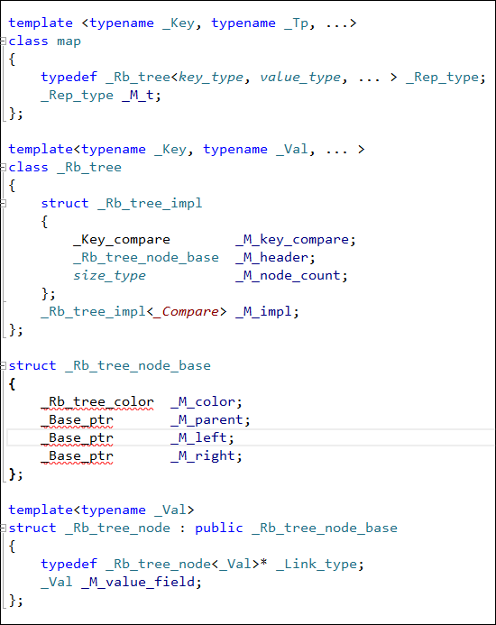
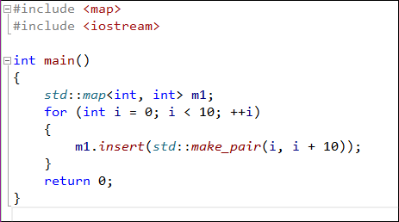
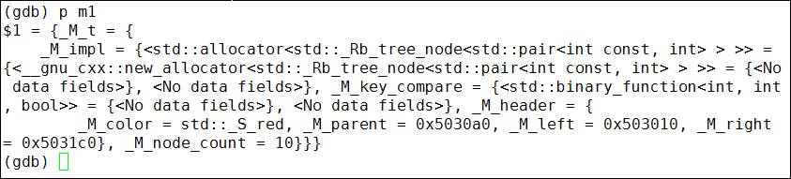
gcc4.1.2 STL Inside——MAP

Slide 10
_M_color
_M_key_compare
_M_parent
_M_color
_M_left
_M_parent
_M_right
_M_left
key
_M_right
value
_M_node_count
_M_color
_M_color
_M_parent
_M_parent
_M_left
_M_left
_M_right
_M_right
key
key
value
value

Slide 11
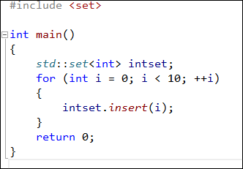
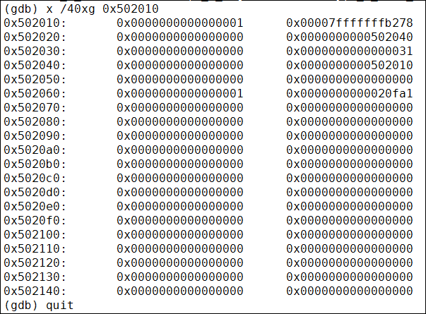
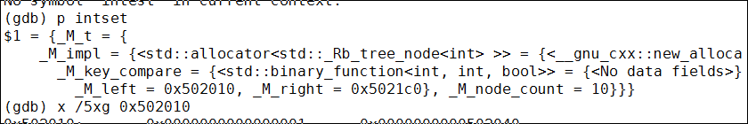
gcc4.1.2 STL Inside——SET
当i=2时内存情况

Slide 12
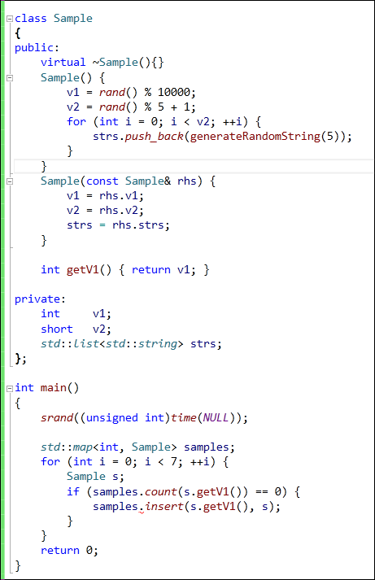
练习4
调试map中的内容

Slide 13
练习5
找一个产品代码中的类进行调试

Slide 14
Q & A

Slide 15
Thank You
For questions or suggestions:
Liu Jie
jieliu@thoughtworks.com

